Slide 1
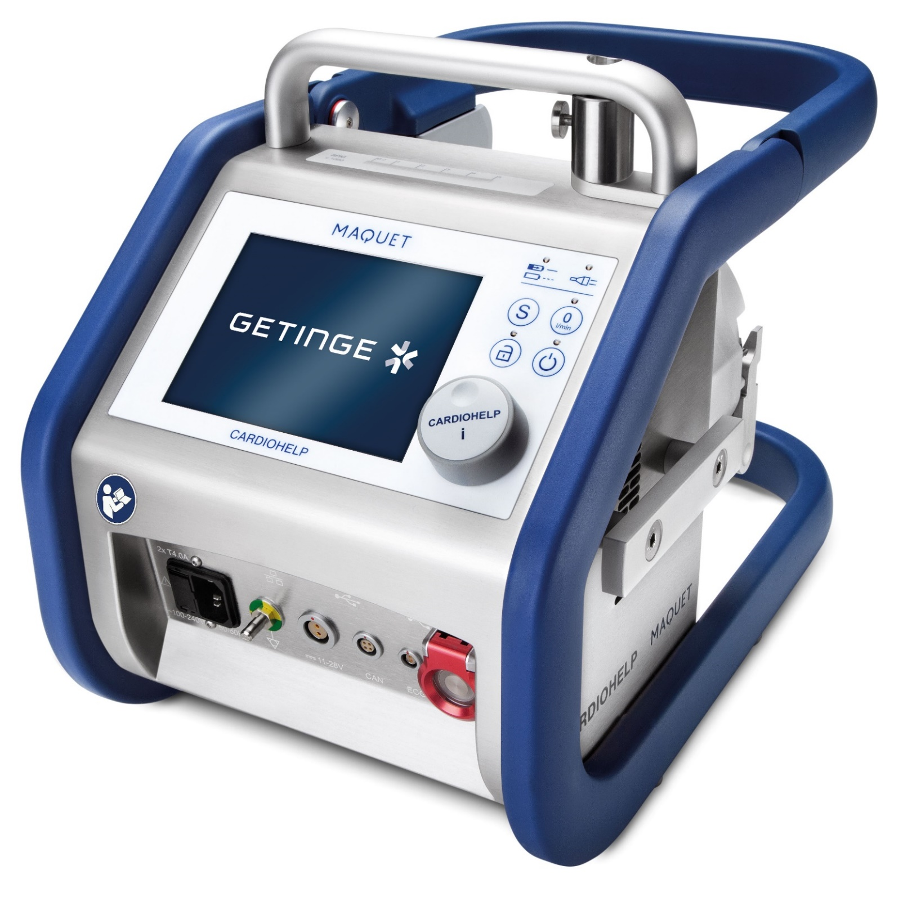
User Training
Cardiohelp Heart-lung Support System
This document is intended to provide information to an international audience outside of the US. Subject to modifications. All images used are for illustrative purposes only and may not accurately represent the product or its use.

Slide 2
Table of Contents
3
Cardiohelp System Overview
30
Controls
5
Connections and Components
46
Patient Safety Mechanisms
13
Disposables: HLS Module Advanced
50
Transport
26
Disposables: Sets with Quadrox-iR
54
Cleaning

Slide 3
Cardiohelp System Overview

Slide 4

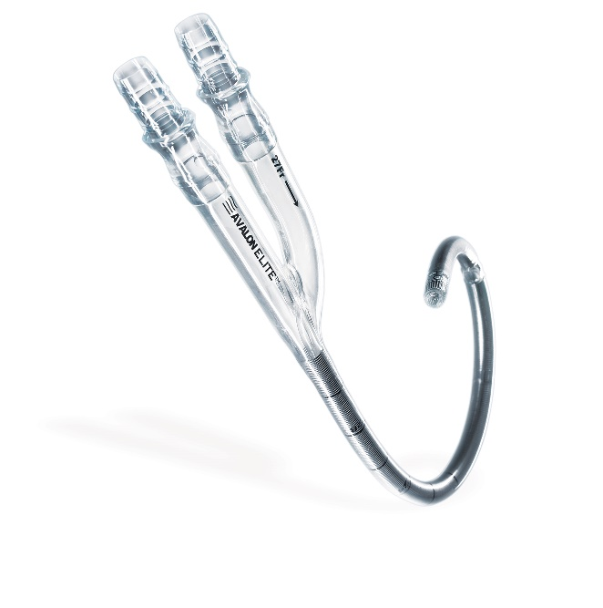
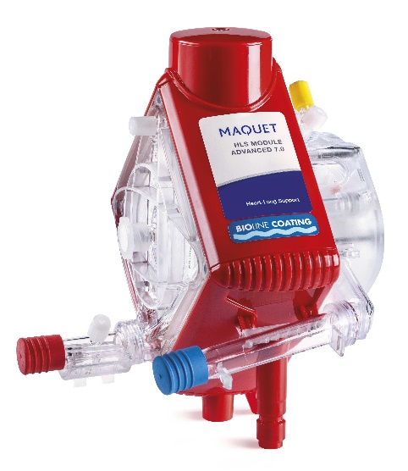
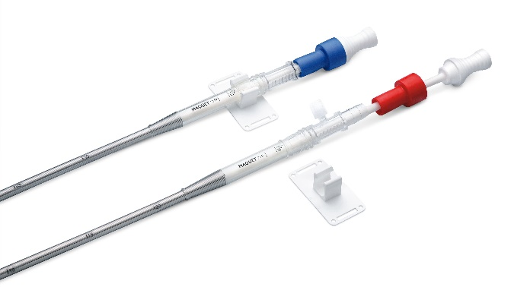
Cardiohelp System Overview
Hardware & Accessories
Cardiohelp Device
Disposable
HLS Set Advanced and other disposable sets
Catheters & Cannulae
HLS Cannulae
Avalon Elite
Refer to the Cardiohelp and HLS Set Advanced IFU. This content is not exhaustive and should not be considered a replacement/substitute.

Slide 5
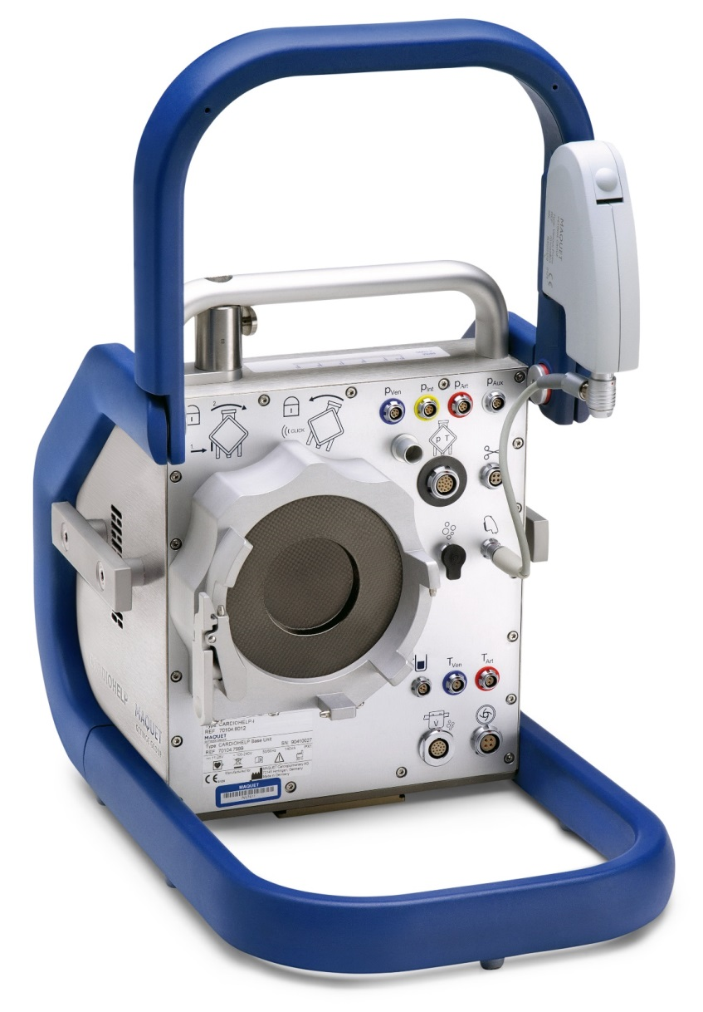
Connections and Components

Slide 6

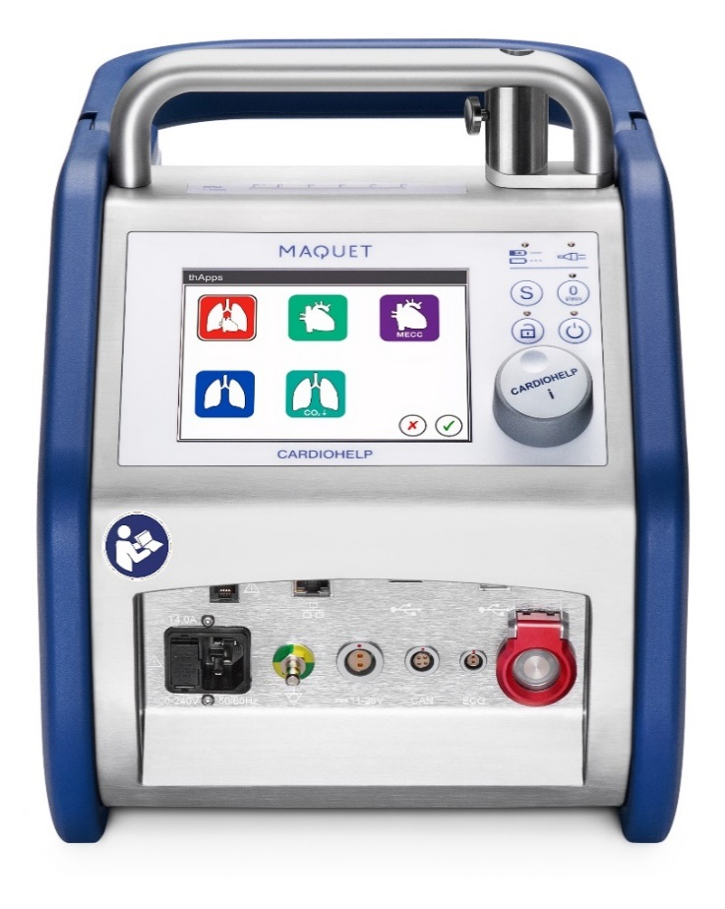
Cardiohelp Connections and components
Connections and components
Front View
Rear View

Slide 7
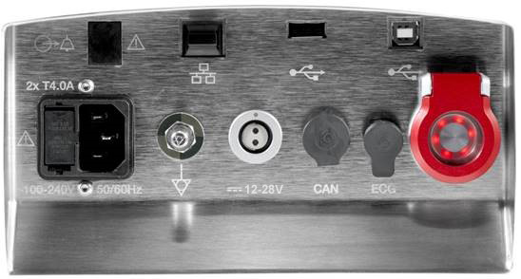
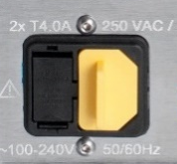

Cardiohelp Connections and components
Front View - Connections
1
2
3
4
[1] Alarm output (Nurse/Ward call)
[2] Ethernet*
[3] USB port type A – for data export to memory stick
[4] USB port type B – for data recording system
[5] AC power supply
[6] Equipotential Bonding Pin
[7] DC power supply
[8] CAN bus interface*
[9] ECG interface*
[10] Emergency Mode button
5
6
7
8
9
10
Keep electrical connections covered by protective caps when not in use.
* Not available
Notes:
Discuss Equipotential Bonding Pin and USB Memory Stick.

Slide 8
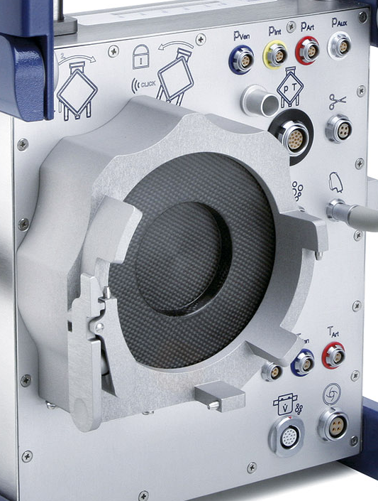
Cardiohelp Connections and components
Rear View - Drive and Sensor Connections
1
[1] External pressure sensors
[2] HLS Internal sensors holder
[3] Clamp*
[4] HLS Internal sensor (pressure and temp)
[5] Drive
[6] Venous probe
[7] Bubble sensor
[8] Fixing pin for HLS Module
[9] External temperature sensors
[10] Unlocking of HLS Module
[11] Level sensor
[12] Flow and bubble sensor
[13] For Battery Calibration
2
3
4
5
6
8
7
9
10
* Not available
11
12
13

Slide 9

Cardiohelp Connections and components
Rear View - Connections
[1] Safety Bar (not a handle!)
[2] Venous probe
[3] Drive

Slide 10
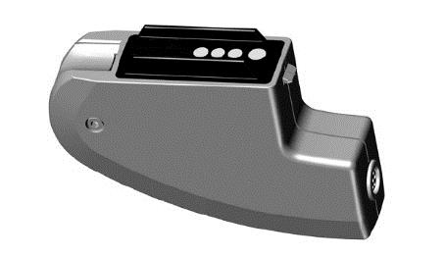
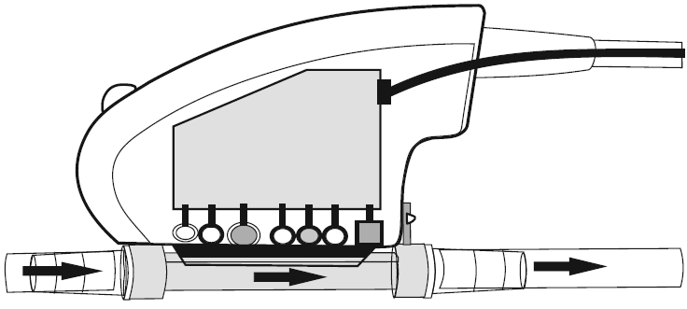
Cardiohelp Connections and components
Sensors – Venous Probe
[1] Optical sensors
  Optical (contactless, spectrometric measurement)
      Hemoglobin Hb
      Hematocrit Hct
      Venous blood saturation SvO₂
  Non-invasive, thermopile infrared sensor
      Venous blood temperature T_{Ven}
[2] Connection for venous probe sensor cable
Venous Probes are matched with Cardiohelp devices. They cannot be switched between units.
Methylene blue and other compounds can affect the optical properties of blood and influence SvO2 Measurements.

Slide 11
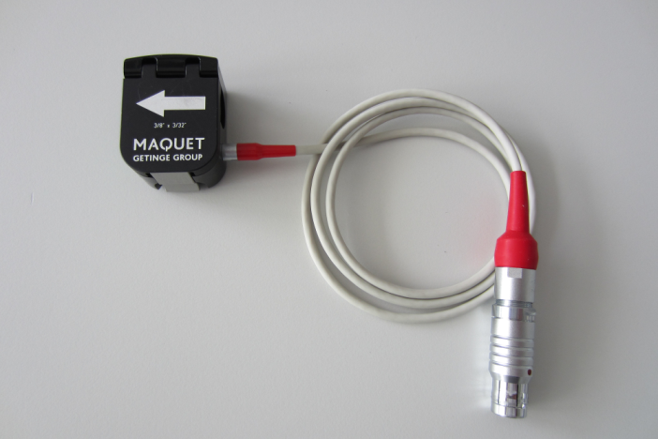
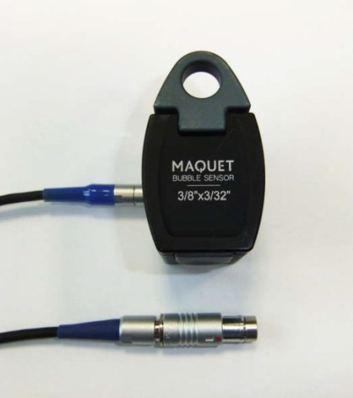
Cardiohelp Connections and components
Sensors - Flow and Bubble
  Arterial Flow-bubble Sensor (FBS)
        3/8” x 3/32”
        Cable length 0.9 m
        Ultrasound detects bubbles ≥ 5mm
  Venous Bubble Sensor (BS) (optional)
        3/8” x 3/32”
        Cable length 1.7 m
        Ultrasound detects bubbles ≥ 5mm
Arterial Flow- Bubble Sensor
Venous Bubble Sensor

Slide 12
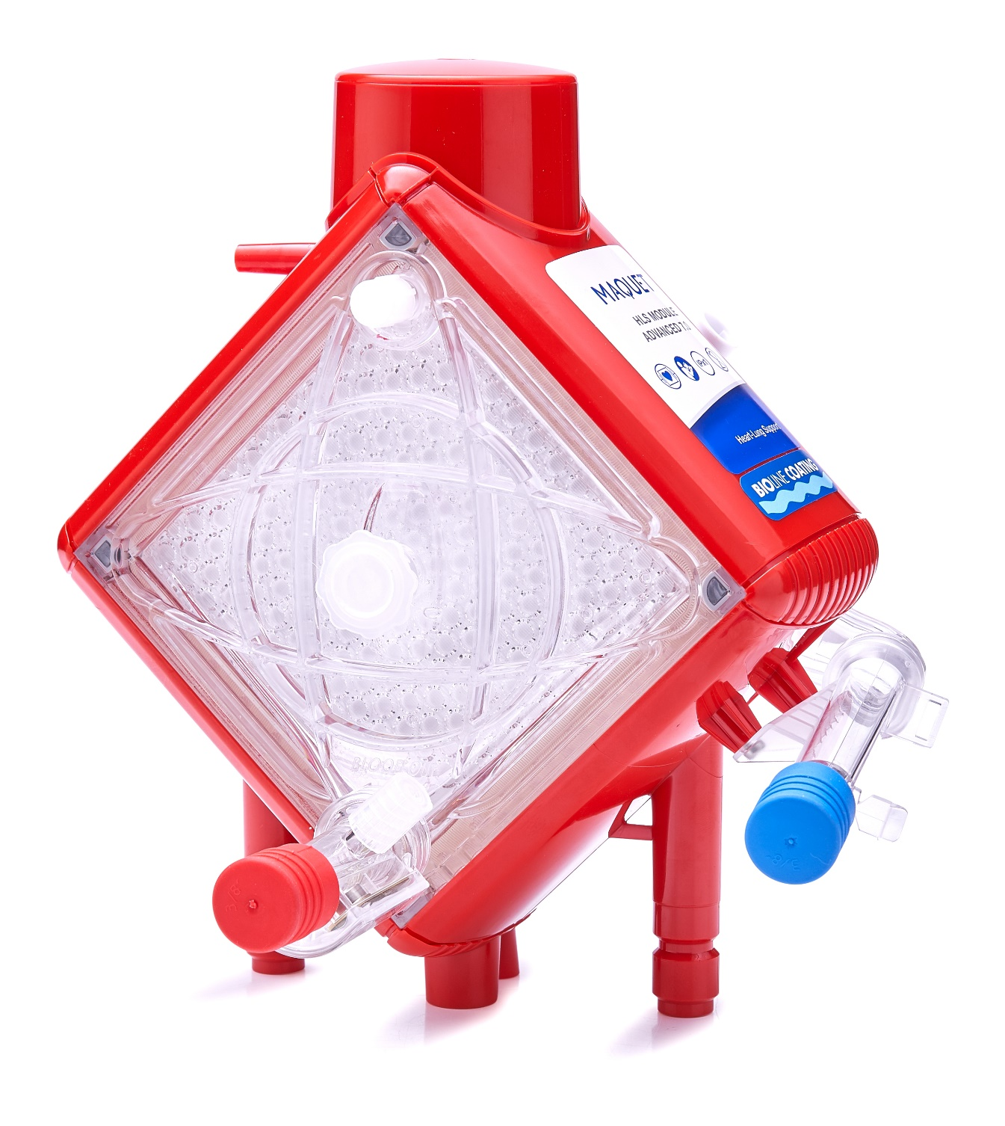
Disposables: HLS Module Advanced

Slide 13
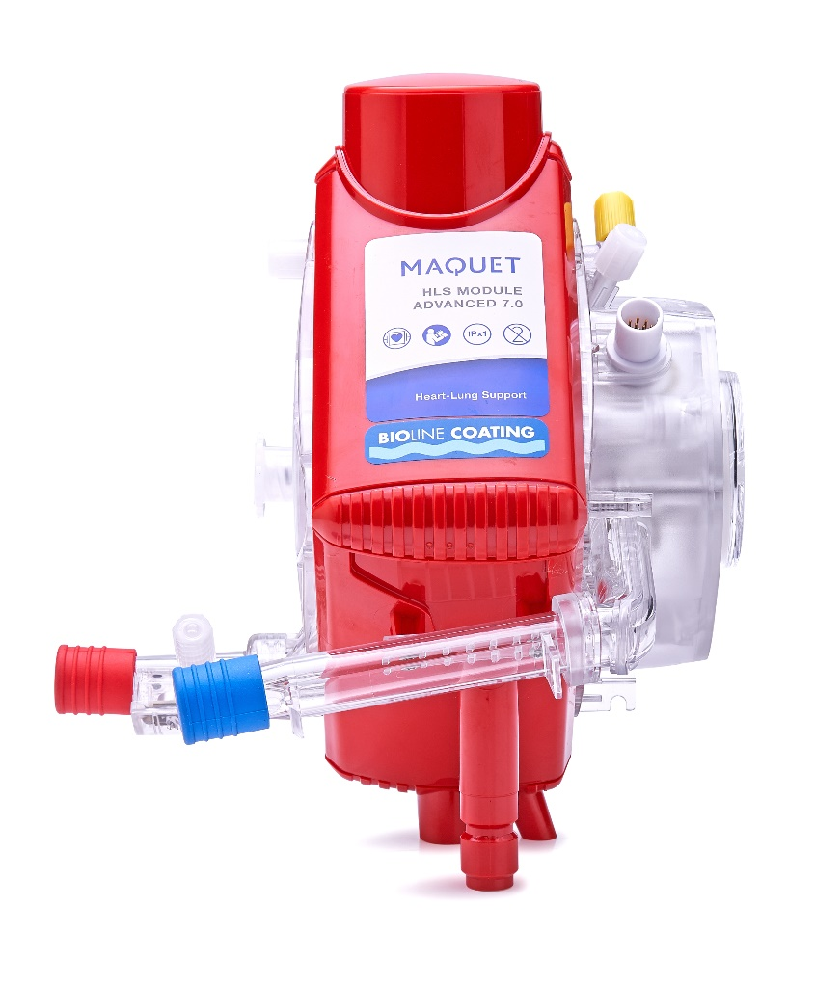
Disposables: HLS Module Advanced
Overview
Integrated Centrifugal Pump
    On the blood inlet side of the diffusion membrane oxygenator
Integrated Pressure Sensors
    Venous pressure p_{Ven} (pre-pump)
    Internal pressure p_{Int} (pre-membrane)
    Arterial pressure p_{Art} (post-membrane)
Integrated Temperature Sensor
    Optical measurement via infra-red sensor
Integrated measuring cell for venous S_{v}O₂, Hb, Hct and temperature.

Slide 14
Disposables: HLS Module Advanced
Technical Specifications
 | HLS Set Advanced 5.0 | HLS Set Advanced 7.0
Blood Flow Range (lpm) | 0.5 – 5.0 | 0.5 – 7.0
Membrane surface area | 1.3 m² | 1.8 m²
Heat Exchanger surface area | 0.3 m² | 0.4 m²
Volume of Set | 570 ml | 600 ml
Coating
*
*Devices with BIOLINE Coating are contraindicated for patients with known hypersensitivity to heparin or patients currently suffering from, or with a history of, type II antibody-related heparin-induced thrombocytopenia (HIT).

Slide 15
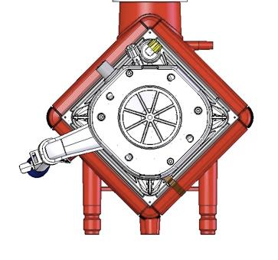
Disposables: HLS Module Advanced
Rear View
Integrated pump on the blood inlet side of the gas-exchanger
7
1
[1] Gas inlet
[2] De-airing membrane
[3] Centrifugal pump
[4] Water connectors
[5] Venous cell
[6] Connection for internal sensors
[7] Venous Sampling
6
2
3
5
4

Slide 16
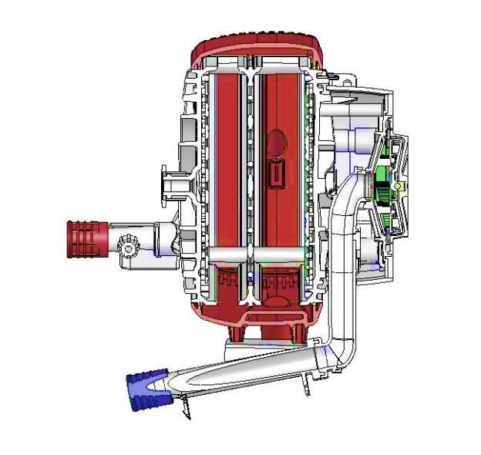
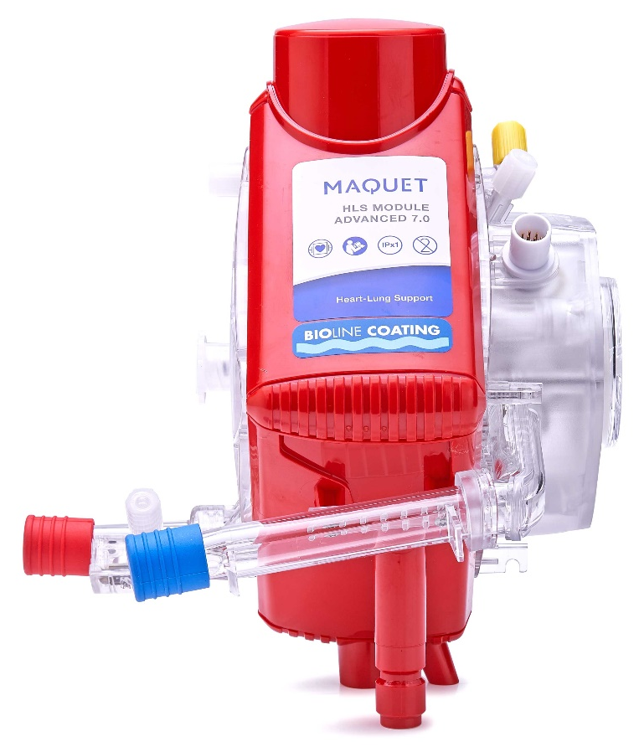
Disposables: HLS Module Advanced
Blood Flow - Inlet
Blood out
Blood in
Blood inlet to the centrifugal pump

Slide 17
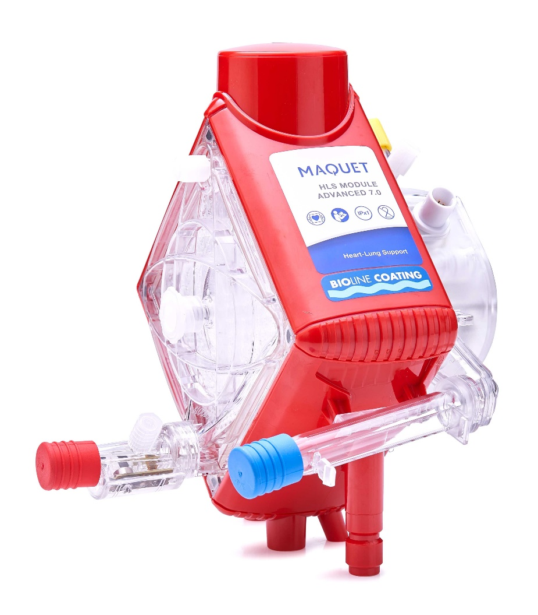
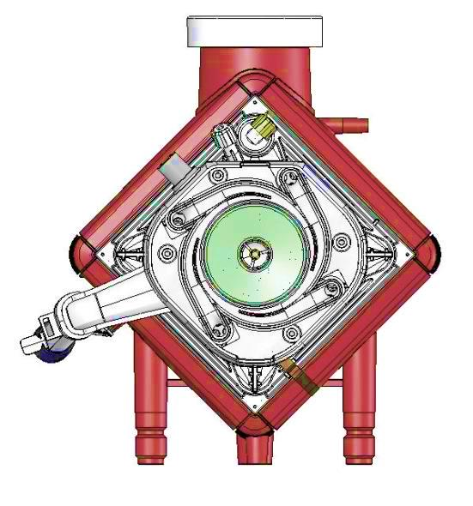
Disposables: HLS Module Advanced
Venous Measuring Cell
Integrated measuring cell for:
S_{V}O₂ - Oxygen Saturation
Hct - Hematocrit
Hb - Hemoglobin
T_{Ven} – Venous Temperature

Slide 18
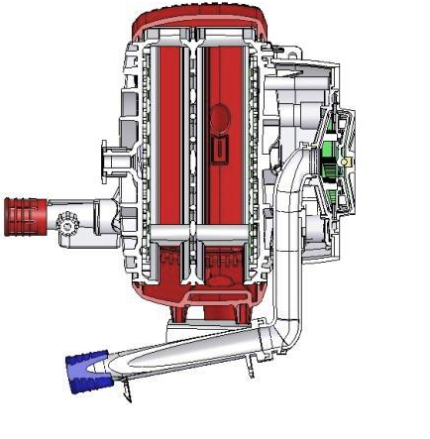
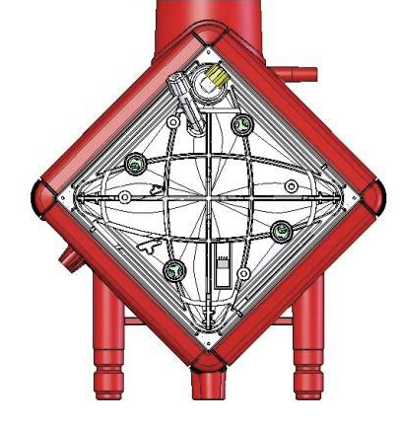
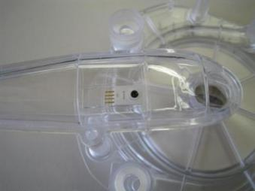
Disposables: HLS Module Advanced
Pressure Measurements
Venous pressure sensor
Pressure sensor post-pump = pressure pre-oxygenator

Slide 19
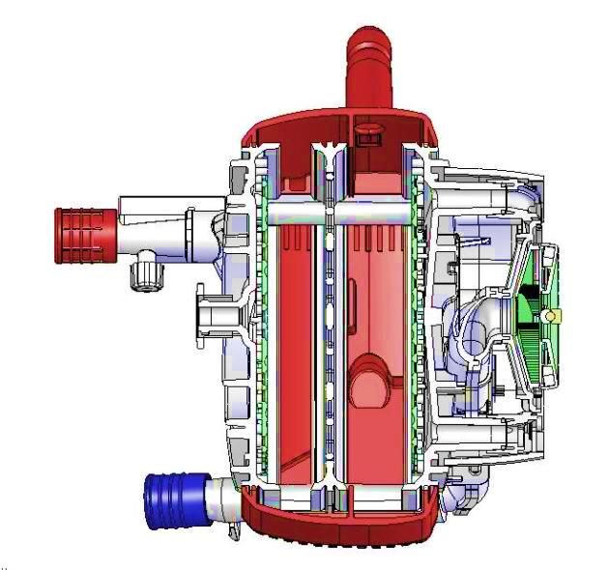
Disposables: HLS Module Advanced
Blood Flow – Centrifugal pump into oxygenator
4 unique blood outlets
1
3
4
2

Slide 20
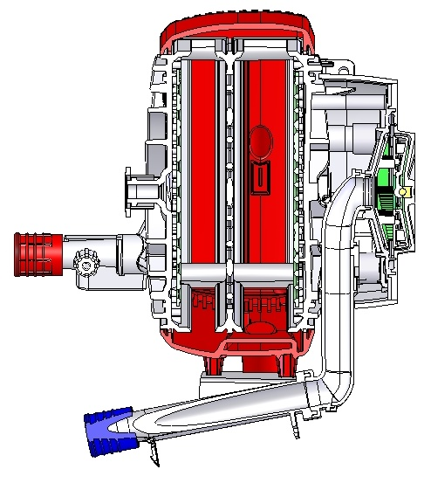
Disposables: HLS Module Advanced
Internal Sensors
Δ p Pressure drop
(calculated from p_{int} - p_{Art})
p_{ven} Venous pressure (pre-pump)
p_{Art} Arterial pressure (post-pump)
T_{art} Arterial temperature
p_{int} Internal pressure (pre-membrane)

Slide 21
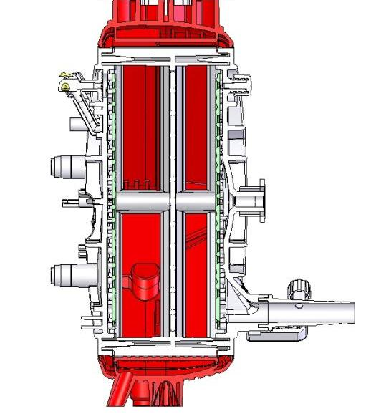
Disposables: HLS Module Advanced
Blood Flow - Oxygenator
De-airing
membrane
Luer port
Blood inlet
Blood outlet

Slide 22
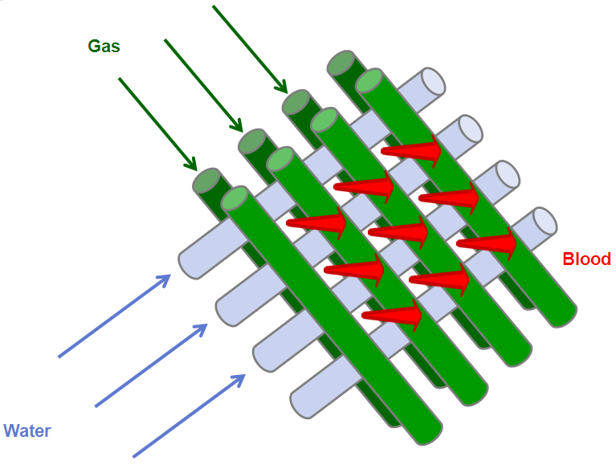
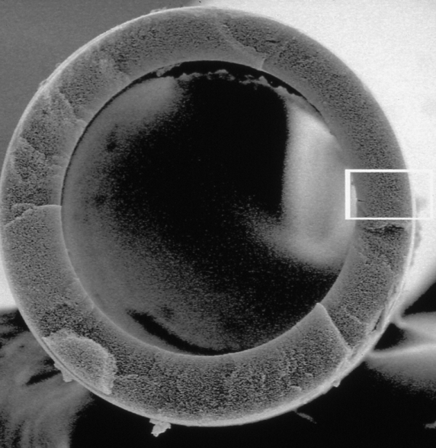
Disposables: HLS Module Advanced
Oxygenator Function
Polymethylpentene Gas Exchange Hollow Fibers
Plasma-tight—O₂ and CO₂ gas exchange through diffusion.
  Not compatible with liquid inhalation anesthetics (e.g. isoflurane, ethrane, enflurane).

Slide 23
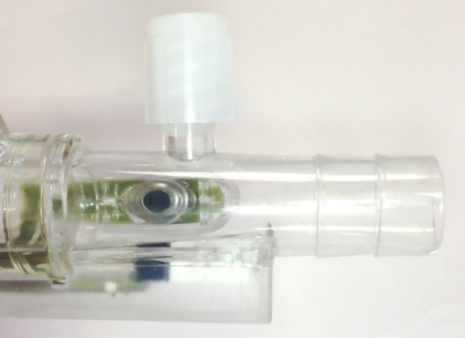
Disposables: HLS Module Advanced
Pressure Measurement (cont.)
Arterial pressure sensor and infrared temperature sensor

Slide 24

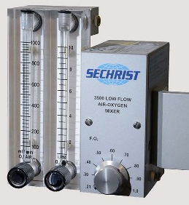
Disposables: HLS Module Advanced
HLS Advanced Layout
Δ P
P_{Ven}
P_{Int}
P_{Art}
T_{Art}
Gas/Heat Exchange
Gas Exchange
Drainage Cannula
Venous Cell
Centrifugal Pump
Return Cannula
Hb
Hct
SvO₂
T_{Ven}
Water Lines
Heater Unit

Slide 25
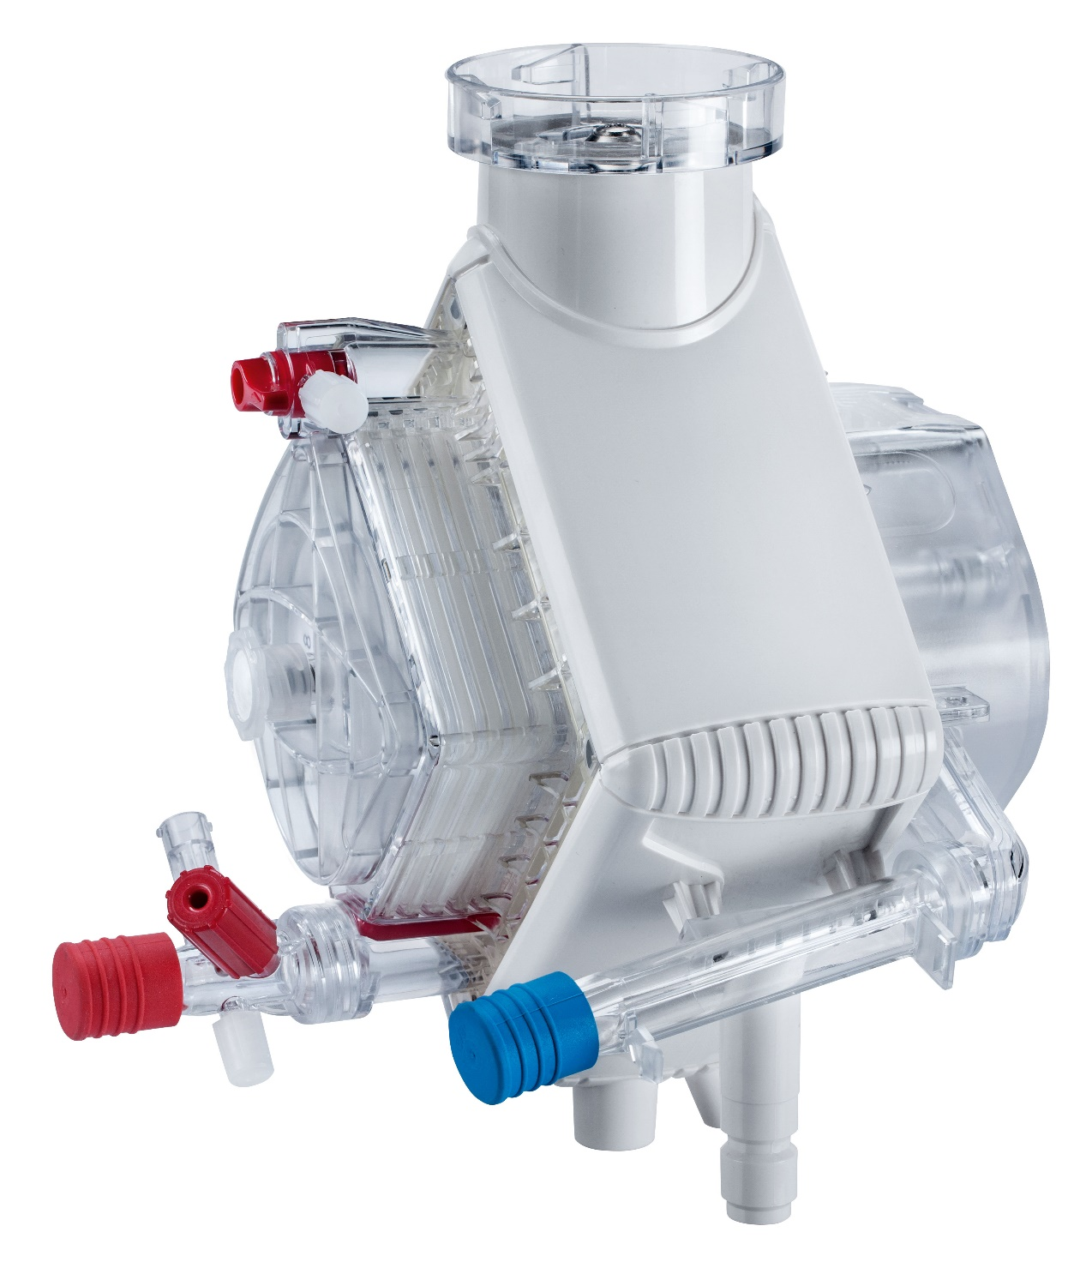
Disposables: Sets with Quadrox-iR

Slide 26
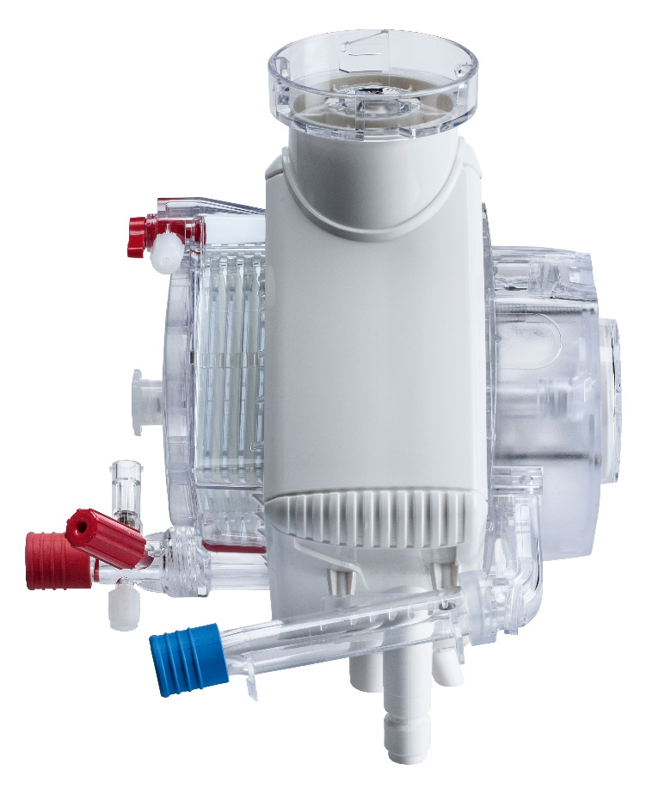
Disposables: HLS Module Advanced
Technical Specifications
 | CIS (Cardiac Intervention Set) | ODP (Organ Donor Perfusion Set)
Catalog Number | CIS 95400 | BE-ODPS 95401 BO-ODPS 95401
Cardiohelp thApp | MECC
Typical Place of Use | Cath Lab, Hybrid OR | ICU, ER, OR
Blood Flow Range (lpm) | 0.5 – 7.0
Volume of Set (ml) | ~600 | ~600
Coating | Uncoated | Bioline, Softline or Uncoated
Duration of Use | ≤ 6 hours
Quadrox-iR Module
Microporous hollow fibers
Same advantages of HLS Set Advanced: low pressure drop, high O₂/CO₂ transfer, efficient heat exchange, low prime volume, 1,8 m² surface area, optional arterial filter.

Slide 27
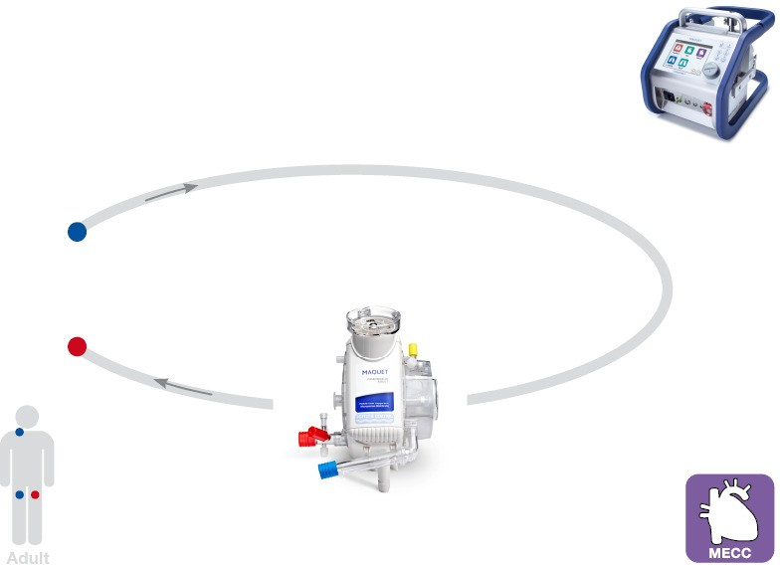
Cardiac Intervention Set – CI Set
Application
Place of use: Cath Lab, Hybrid OR
Fields of application:
  Acute cardiopulmonary arrest or severe cardiogenic shock during intervention
  Stand-by or prophylactic support during e.g. high risk PCI
  Bridge to decision
Display will not be locked after 3 minutes

Slide 28
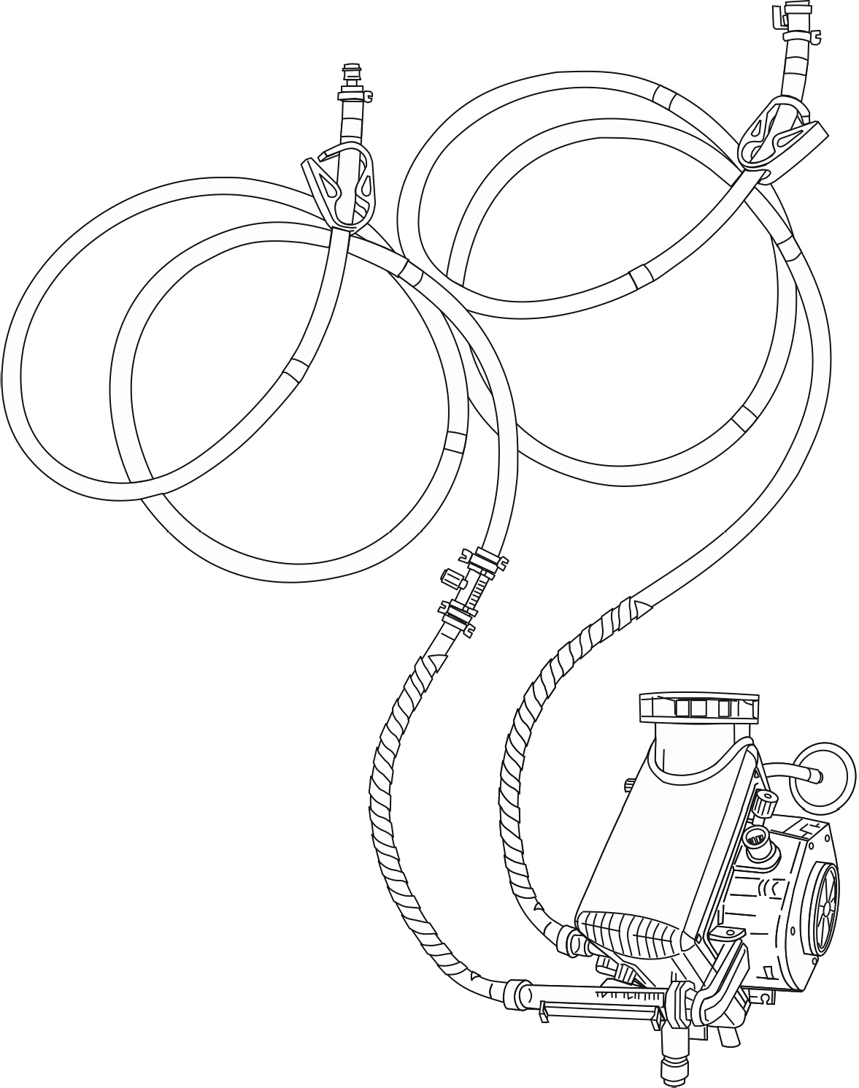
Cardiac Intervention Set – ODP Set
Application
Place of use: ICU, ER, OR
Fields of application:
  Cadaver perfusion, donation after cardiac death (DCD)
  Bridge to explant
  Allowed in specific countries
Level sensor (drib chamber)

Slide 29

Controls

Slide 30
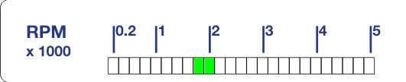
Controls
Control Panel
1
[1] LED speed indicator
[2] Graphical user interface (GUI)
[3] Battery LED
[4] Power supply LED
[5] Safety button
[6] Zero flow mode LED & button
[7] ON/OFF LED & button
[8] Lock/Unlock LED & button
[9] Rotary knob
2
3
4
5
6
7
8
9

Slide 31
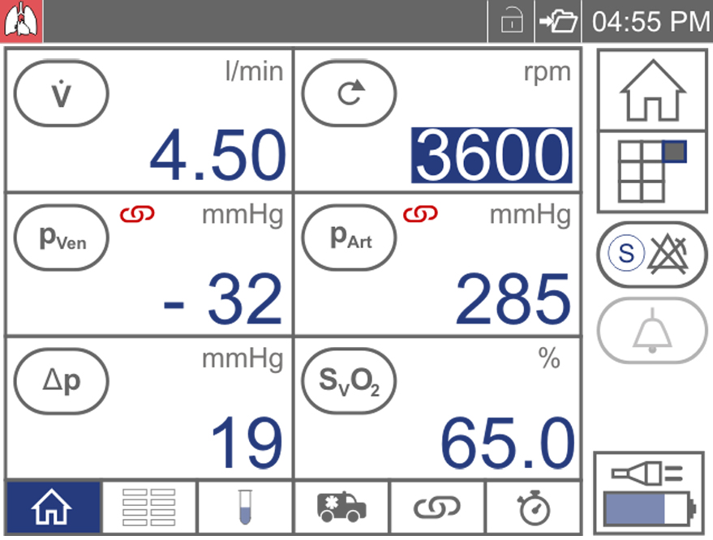
Controls
User Interface – Circulatory and Pulmonary Support
1
2
3
[1] thApp
[2] LPM data
[3] RPM data
[4] Startup screen
[5] Menu screen
[6] Global override
[7] Alarm pause
[8] Power supply status
[9] Tab bar
[10] Parameter display
4
5
6
10
7
8
9

Slide 32
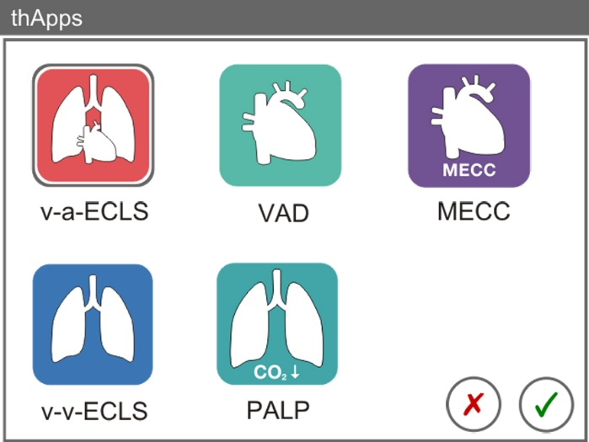
Controls
Menu Options

Slide 33

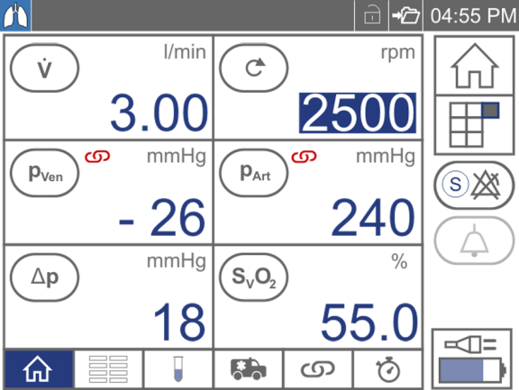
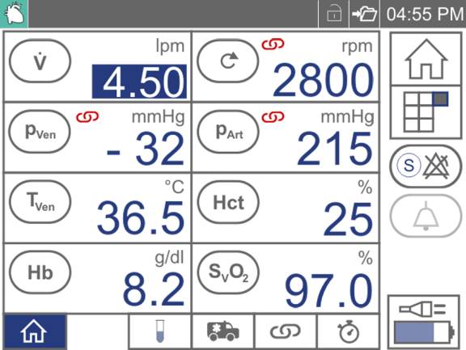
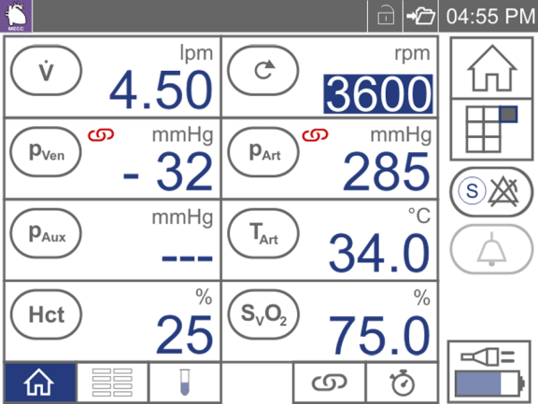
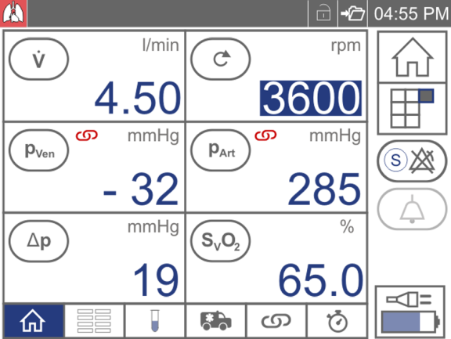
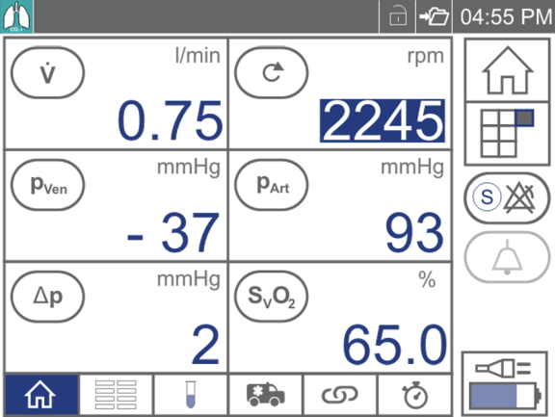
Controls
Flexible Therapy Driven Information

Slide 34

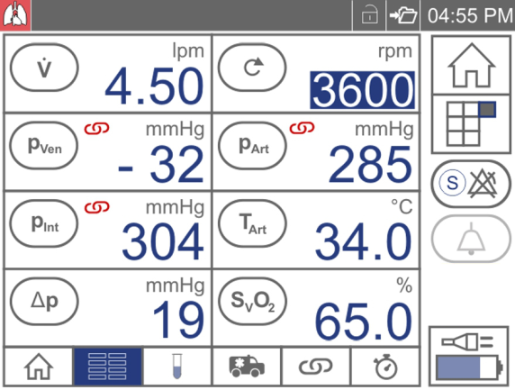
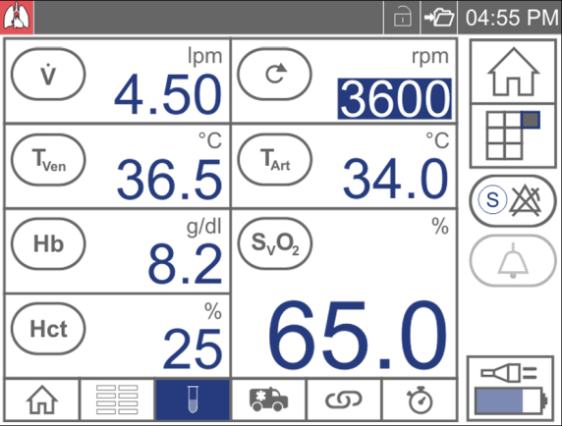
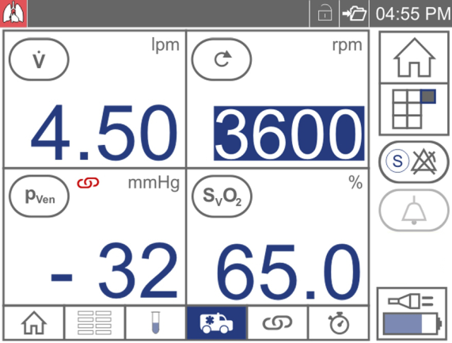
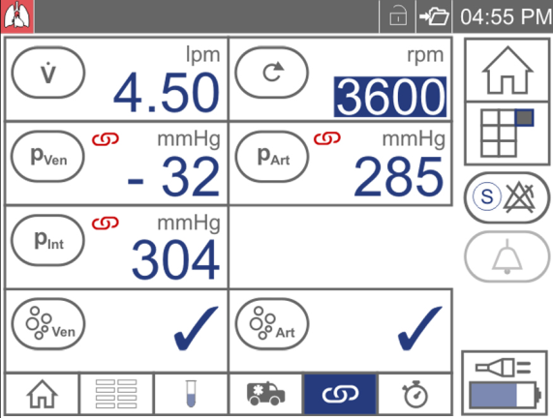
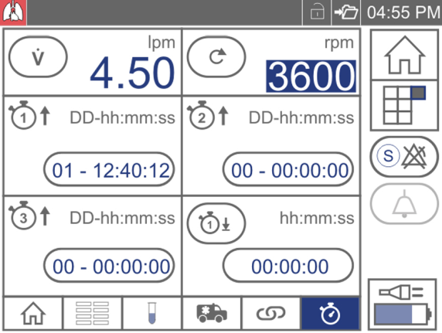
Controls
Tab Screens – Circulatory and Pulmonary Support

Slide 35
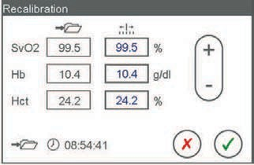
Controls
Blood Parameters
  Select any blood parameter (SvO2, Hb or Hct) to enter menu.
  [1] Initialize probe if needed
  (while attached to safety bar).
  Recalibrate SvO₂, Hb and Hct with lab values:
  [2] Save reference values. At the same time, take a blood sample.
  Once the values come back from the laboratory:
    select [3] Recalibrate Values.
    Confirm that the lab value corresponds to the time saved [a].
    Enter lab values in the fields [b]. Confirm.
2
b
3
1
a
Notes:
Cardiohelp User Manual Section 6.3.1 Recalibrating Blood Parameters

Slide 36
Controls
Warning Limits, Alarm Limits and Intervention Controls
Alarm Limit – when exceeded, triggers alarm and Intervention (when active).
Warning Limit – triggers alarm when exceeded.
When Intervention active, exceeding Alarm Limit can increase/reduce pump speed, stop the pump, or go into backflow prevention (depending on the specific parameter).
Deactivate Upper Limit: press [+] until [---] is displayed
Deactivate Lower Limit: press [-] until [---] is displayed
Notes:
Cardiohelp User Manual Section 6.1 Physiological Alarms and Interventions

Slide 37
Controls
Flow Alarm
Calibrate flow sensor with no flow and tubing clamped upstream and downstream.
High-priority alarm when Flow Warning Limit exceeded
Notes:
Cardiohelp User Manual Section 6.1 Physiological Alarms and Interventions

Slide 38


Controls
Flow Monitoring
Backflow Prevention
  Cardiohelp monitors blood flow and detects and responds to backflow of blood.
  Backflow of -0.1 l/min is the fixed Alarm Limit:
      1 second of backflow → medium-priority alarm
      6 seconds of backflow → high-priority alarm and zero flow mode activates
  Backflow Prevention can also be triggered by a Venous Bubble Intervention.
  Zero Flow Mode
  CARDIOHELP targets a flow of 0 l/min by controlling the pump accordingly (both forward and reverse)
  The Zero Flow Mode can be activated manually or automatically by Backflow Prevention.
  Activate Zero Flow Mode: hold down the “Safety” button and press the “Zero Flow Mode” button .
  Deactivate Zero Flow Mode: increase RPM high enough to ensure forward flow. press the “Zero Flow Mode” button .
Notes:
Backflow Prevention: Cardiohelp User Manual Section 6.2.1 Flow Monitoring
Zero Flow Mode: Cardiohelp User Manual Section 3.3.2 Keypad
Can be demonstrated by applying pressure from the Emergency Prime Line

Slide 39
Controls
Pump Speed Monitoring (only in LPM Mode)
When Alarm Limit exceeded, intervention will reduce/increase pump speed and cause med-priority alarm.
Low-priority alarm when Alarm Limit exceeded (Intervention off)
Setting an appropriate RPM alarm always recommended.
RPM Alarms/Intervention only available in LPM Mode. RPM Intervention not enabled when switching to LPM mode.
Notes:
Cardiohelp User Manual Section 6.1 Physiological Alarms and Interventions

Slide 40
Controls
Interventions - Pressure
Only lower limits available for p_{Ven}. Only upper limits available for p_{Art} und p_{Int}.
Zero sensor when HLS Set is empty.
Low-priority alarm when Warning Limit exceeded.
When exceeding the Alarm Limit by <10 mmHg with intervention on, Cardiohelp automatically controls the pump speed and generates a medium-priority alarm. Exceeding the Alarm Limit by >10 mmHg will stop the pump and cause high-priority alarm.
Low-priority alarm when intervention off and Alarm Limit exceeded.
Notes:
Cardiohelp User Manual Section 6.1 Physiological Alarms and Interventions

Slide 41
Controls
Bubble Monitoring
Microbubbles ≥ 5 mm triggers alarm. Smaller bubbles may be detected.
High-priority alarm when bubble detected. Arterial FBS intervention stops the pump and Venous BS intervention activates backflow prevention.
Low-priority alarm when bubble detected (Intervention off).
To reset the bubble alarm.
Notes:
Cardiohelp User Manual Section 6.1 Physiological Alarms and Interventions

Slide 42
Controls
Other Alarms
Other Warning Limits generate low-priority alarms when exceeded:
Pressure Drop (Δp)
Temperature (T_{Art},T_{Ven})
Blood Parameters (SvO₂, Hb and Hct)

Slide 43
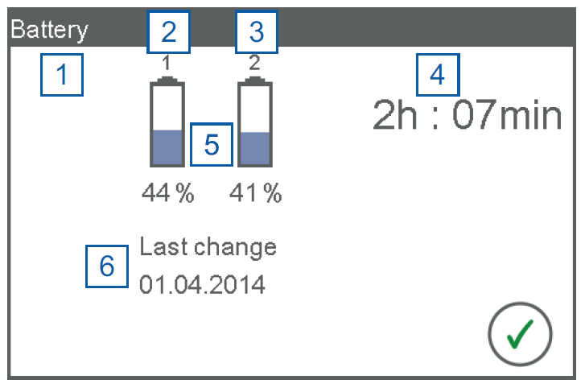

Controls
Battery Power
[1] charging and power supply status
[2], [3], [5] Battery Status
[4] Remaining battery time
[6] Date of last battery change
Unplugging external power: audible alarm and pop-up message.
Battery <20%: medium priority alarm
Battery <10%: high-priority alarm
Battery life: at least 90 minutes (with fully charged batteries)
Notes:
Cardiohelp User Manual Section 4.9.2 Displaying Battery Status

Slide 44
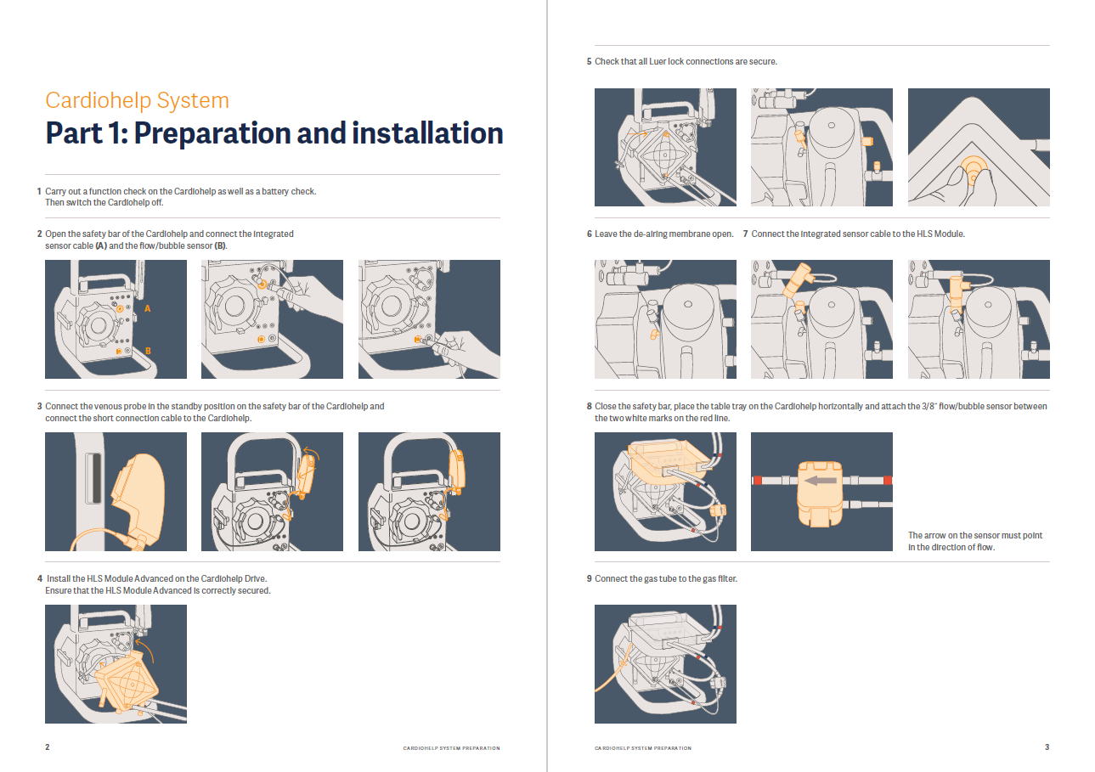

Cardiohelp Set-up & Priming
See Cardiohelp System Set-up Guide:
Preparation & Installation
Priming the System
Connecting to the Patient
Starting Perfusion
Ending Perfusion
Notes:
https://getinge.training/all-courses/cardiohelp-outside-us/

Slide 45

Patient Safety Mechanisms

Slide 46

Patient Safety Mechanisms
Emergency Drive
Clamp red and blue lines.
If applicable, mount the Emergency Drive on the Cardiohelp or on the Sprinter Cart Emergency Drive Holder.
Open the Safety Bar
Disconnect: a) Integrated Sensor Cable, b) Venous Probe and c) Transport Guard (if applicable).
If needed, temporarily stop the flow of the Heater Unit and disconnect Water Lines while the HLS Set is being moved.
Disconnect the HLS Set from the Cardiohelp.
[1] Align the top of the HLS Set into the emergency drive puncturing the protective film. [2] Press the locking switch while swinging the bottom part of the HLS Set into place.
Release clamps and start turning the hand crank clockwise at the desired speed.
Transfer to new Cardiohelp asap.
Provides manual drive to the HLS Set if the Cardiohelp fails.
  Always keep Emergency Drive accessible at all times.
Refer to the Cardiohelp IFU Section 6.4.4 Using the Emergency Drive with the Disposable HLS Retainer and HLS Set IFU Section 8.3 Replacing the Set
Notes:
Cardiohelp User Manual Section 6.4.4 Using the Emergency Drive with the Disposable HLS Retainer
Difference in Drive attachment and E-drive attachment. This is a redundancy in case the three plastic fixation tabs on the module get damaged.

Slide 47

Patient Safety Mechanisms
Emergency Mode
Safe perfusion even with a damaged display or controls
      Activate Emergency Mode: press Emergency Mode button waiting for 3 beeps and release.
      Note: alarms are also deactivated (not mentioned in the pop-up message)
      Exit Emergency Mode: switch off Cardiohelp by pressing the Emergency Mode button releasing after 10 beeps and a long tone.
Notes:
Cardiohelp User Manual Section 6.4.3 Using the Emergency Mode

Slide 48


Patient Safety Mechanisms
Emergency Priming Line
To remove air from the blue line before it has reached the oxygenator.
Clamp Red Line and reduce pump speed to 0 rpm (display will read 0, but continue to turn knob counter-clockwise).
Clamp Blue Line and the Venous Cannula.
Prime the Emergency Priming Line.
Attach Emergency Priming Line to dialysis lock ensuring air-free connection.
Disconnect the connection between the venous cannula and the Blue Line.
Remove air by releasing clamp from the Blue Line and push priming solution retrograde into the Blue Line.
Clamp the Emergency Prime Line.
Form an air-free connection between the de-aired Blue Line and the venous cannula.
Remove clamp from the Red Line.
Reset Venous Bubble Sensor (if applicable).
Restart perfusion.
Remove Emergency Priming Line.
See HLS Set IFU Section 8.1 Using the Emergency Priming Line for full instructions.
Notes:
HLS Set IFU Section 7.1 Using the Emergency Priming Line.

Slide 49

Transport

Slide 50






Transport
Transport Accessories
Sprinter Cart XL
Mobile Holder (HKH 8860) includes Protection Cover
Trolley Transport System
Base Plate (HKH 8850)
Wall Holder (HKH 8820)
Notes:
Cardiohelp User Manual Section 4.1.3 Attaching the CARDIOHELP to the Mobile Holder HKH 8860
All info contained in IFU “Patient Transport Accessories for Patient Transport” is also repeated in the Cardiohelp IFU

Slide 51



Transport
Transport Accessories
Transport Guard
Provides extra securement for disposables during transport. For inter-hospital transport and intra-hospital transport without a Sprinter Cart.
Transport Case
Stores Emergency Drive and Transport Guard when not in use. Emergency drive must be stored in case during inter-hospital transport.
Notes:
Cardiohelp User Manual Section 4.1 Installing Accessories for Patient Transportation

Slide 52

Transport
Preparing for Inter-Hospital Transport
  Disconnect non-essential connections (if applicable: nurse call, USB cable, heater water lines, etc.)
  Check function of transport equipment
    Mount Transport Guard onto Cardiohelp
    Transport Emergency Drive with patient in Transport Case
    Bring protective (rain) cover
  Transfer gas supply (gas tank)
  Unplug from electrical outlet and check batteries. Recommend leaving power cable plugged into Cardiohelp, but use yellow plug cover if it is removed.
  Mount Cardiohelp on Transport Accessories including Mobile Holder.
Notes:
Cardiohelp User Manual Section 5.6.2 Check Before Every Use in Transportation

Slide 53
Cleaning

Slide 54
Cleaning
Clean and disinfect after each use.
Only use approved cleaning agents and disinfectants.
Cleaning the Venous Probe
    Detach push-button for better cleaning.
    Only use lint-free cloth and water to clean the Venous Probe’s sensors
Refer to the Cardiohelp IFU Section 10 Cleaning and Disinfection
Notes:
Cardiohelp User Manual Section 10 Cleaning and Disinfection

Slide 55
Questions?
This document is intended to provide information to an international audience outside of the US.
The products in this brochure may be pending regulatory approvals to be marketed in your country. Contact your Getinge representative for more information.
Cardiohelp, Avalon Elite, Bioline Coating are a registered Trademark by Maquet Cardiopulmonary GmbH
Manufacturer · Maquet Cardiopulmonary GmbH · Kehler Str. 31 · 76437 Rastatt · Germany · +49 7222 932-0

