Slide 1
Management of a Suspected Intra-aortic Balloon Perforation

Slide 2
Suspected IAB perforation
Causes
Contact with a sharp instrument
Fatigue failure due to unusual (biaxial) folding of the balloon membrane during use
Contact with calcified plaque resulting in abrasion of the surface and eventual perforation
Calcific plaque in aorta

Slide 3
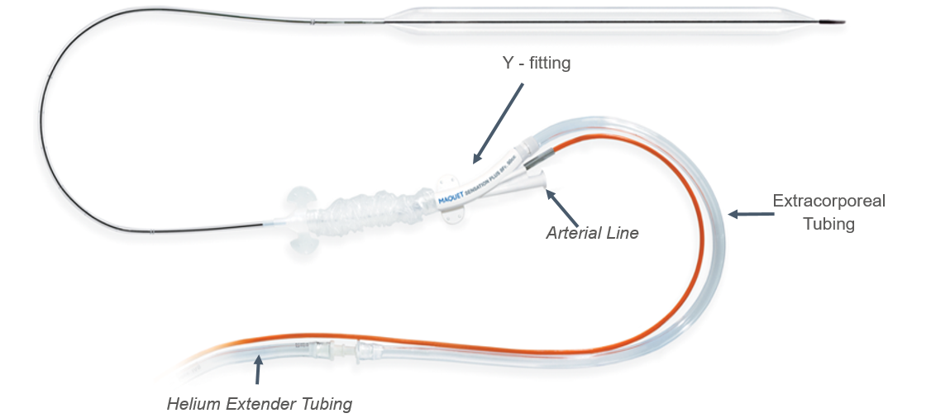
Suspected IAB perforation
Evidence of blood
Blood or fluid in the extracorporeal tubing or catheter extender indicated by:
Bright red blood
Dried blood particles
Serosanguineous fluid

Slide 4
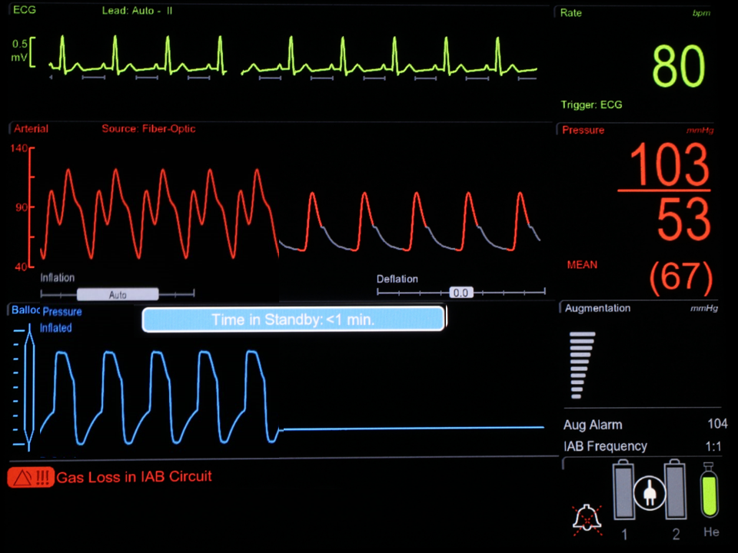
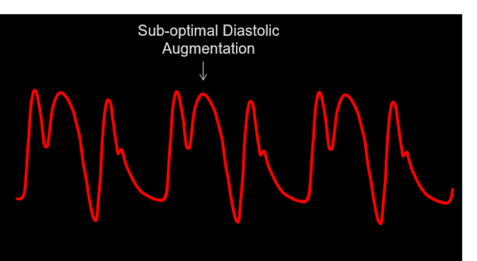
Suspected IAB perforation
Other indicators of an IAB perforation
Sudden change in the diastolic augmentation pressure
Possible IABP alarms
MCA00001677 Rev B / MCV00109704 REVB
8 September 2023
Page 4

Slide 5
Suspected IAB Perforation Troubleshooting
Blood or fluid may be seen in the extracorporeal tubing or catheter extender as evidenced by:
Bright red blood
Dried blood particles
Serosanguineous fluid
During an autofill | Outside an autofill period
Potential alarms: Autofill Failure – Blood Suspected Autofill Failure | Potential alarms: Gas Loss in IAB Circuit Gas Gain in IAB Circuit IAB Catheter Restriction
Regularly inspect the IAB catheter tubing for the presence of blood during therapy and when the mentioned alarms occur.
Do not disregard the alarms, and carefully heed the specified alarm’s corrective actions.
These alarms play a crucial role in potentially detecting a perforated balloon earlier, preventing the possibility of blood entering the IABP system.
MCA00001677 Rev B / MCV00109704 REVB
8 September 2023
Page 5

Slide 6
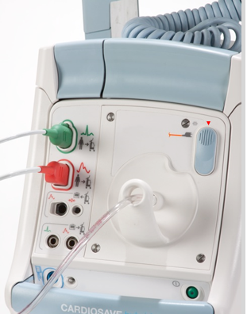
Suspected IAB perforation
Troubleshooting
If any blood is noted or perforation is suspected, the following procedure must be performed immediately:
1. Stop pumping by placing IABP console in Standby
2. Disconnect the catheter extender tubing from the IABP console to allow the balloon to deflate
3. Clamp extracorporeal tubing between white y-fitting and male connector
Notify physician and prepare for IAB catheter removal.
Consider IAB catheter replacement, if the patient’s condition warrants
If blood is suspected of having entered the pump, take pump out of service. It should be evaluated before use in another patient by Biomed/Technical Service to determine if replacement of contaminated components are necessary.
1
2
3
Standby
Disconnect
Clamp

Slide 7
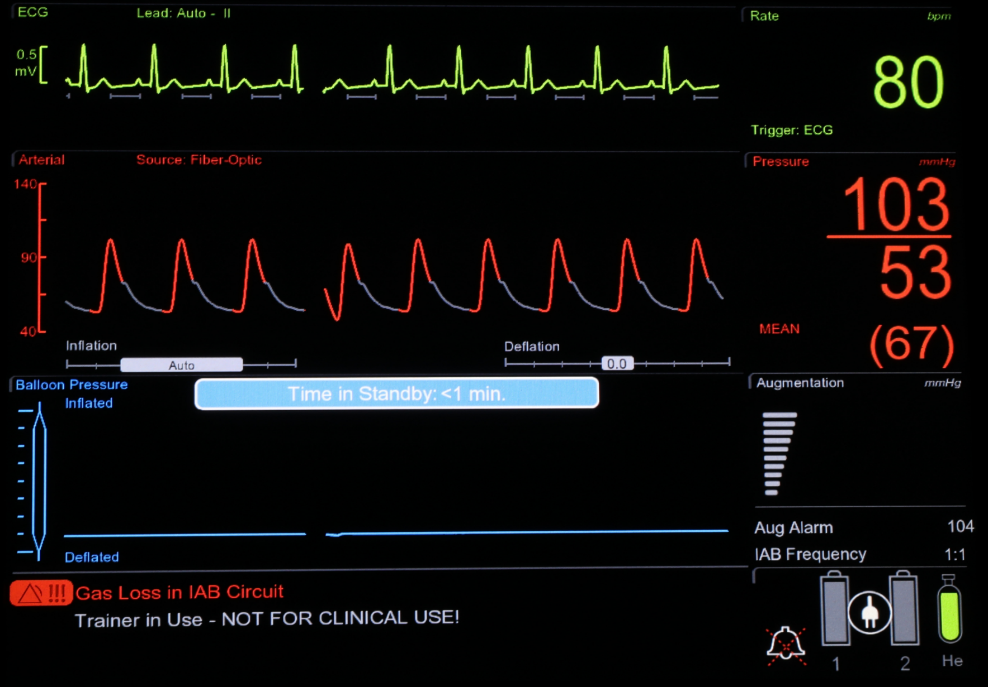
Risk to health
An unexpected shutdown can occur if blood is permitted to enter the Cardiosave IABP. This event is referred to as a “blood back”.
This may threaten the hemodynamic stability of the supported patient as the user is left unaware of the status of the IABP.
Additionally, any subsequent attempts to use the affected console that experienced a blood back event without reconditioning may delay future therapy delivery.
The user and subsequent maintenance or service personnel can be exposed to an unexpected biohazard if proper containment precautions are not taken.
Subsequent patients may be exposed to an unexpected biohazard if an affected console is not appropriately serviced prior to use.

Slide 8
Suspected IAB Perforation
Summary
Timely detection and an appropriate response to indicators are fundamental to managing IAB perforation effectively.
In situations involving suspected IAB perforation, follow the outlined procedures.
Immediate action helps prevent further complications and ensures patient safety.
MCA00001677 Rev B / MCV00109704 REVB
8 September 2023

Slide 9
Questions?

Slide 10
MCA00001677 REVB · Getinge and are trademarks or registered trademarks of Getinge AB, its subsidiaries, or aﬃliates in the United States or other countries · Copyright 2023 Datascope Corp. · All rights reserved · CAUTION: Federal (U.S.A.) law restricts this device to sale, distribution and use by or on the order of a physician. Refer to Instructions for Use for current indications, warnings, contraindications and precautions · 09/2023 · MCV00109704 REVB
Getinge · 45 Barbour Pond Dr., Wayne, NJ 07470, USA
Page 10

