Slide 1
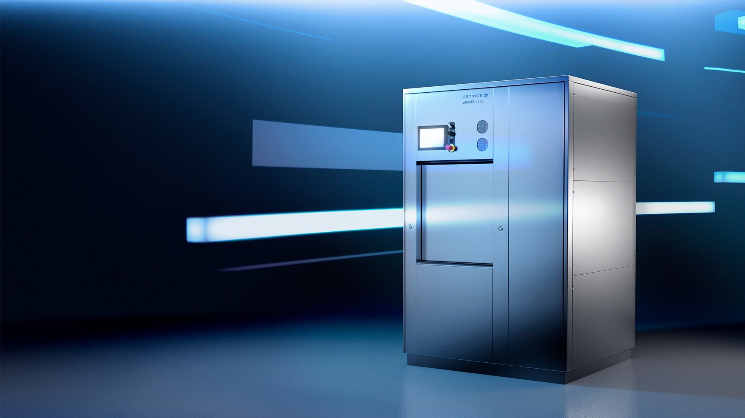

Getinge Lancer LSS
Laboratory Steam Sterilizer
Efficiency at
your fingertips

Slide 2
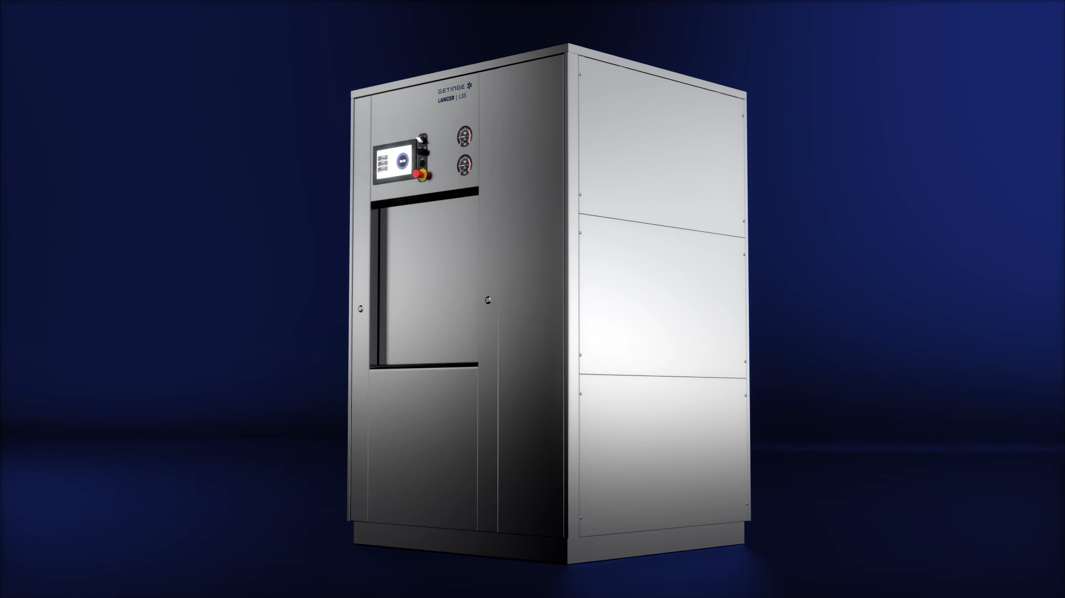
Upgrade your lab
With intuitive controls
Designed to withstand laboratory environments, the new Lancer LSS sterilizer combines engineering and construction with an intuitive interface.

Slide 3






Repeatable results
At your lab or research facility
Sterilization
Continuous monitoring and validation
Documentation according to your needs
Adjustable cycle parameters
Printable batch reports

Slide 4
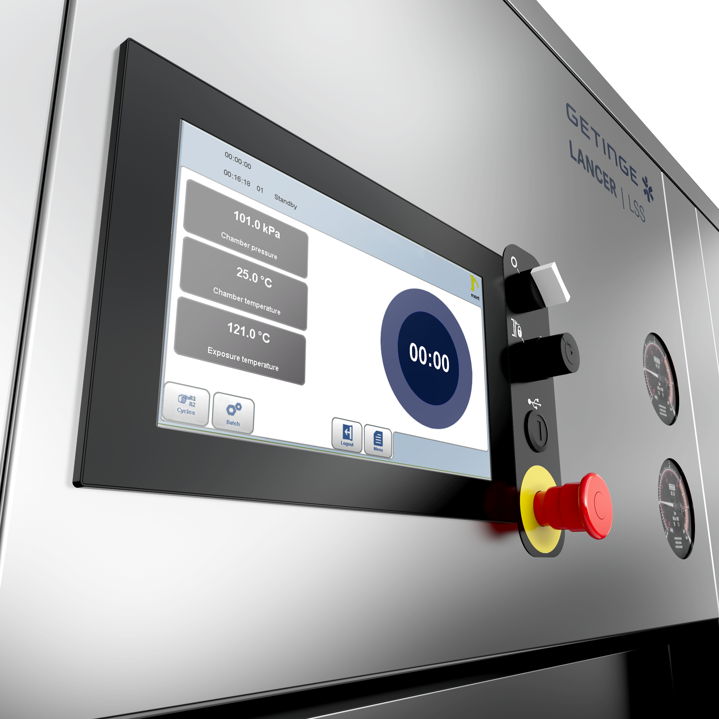
Intuitive control system
Helps streamline workflow
Intuitive HMI enables fast and easy operations
Comprehensive user management with different access levels
Connect to external systems such as SCADA and BMS through OPC UA standardised protocols
Lancer LSS can also connect with Getinge Online enabling you to monitor your equipment remotely
Network printing and network storage available
Alarm notifications

Slide 5

Support flexible processes in your lab
Lancer LSS is designed for your process requirements
Glassware, hoses, liquids - the Lancer LSS enables a wide range of loads.
Liquids in closed containers is available as an option.
Pre-programmed sterilization cycles for the most common loads
Customised sterilization cycles and parameters for your unique process requirements

Slide 6
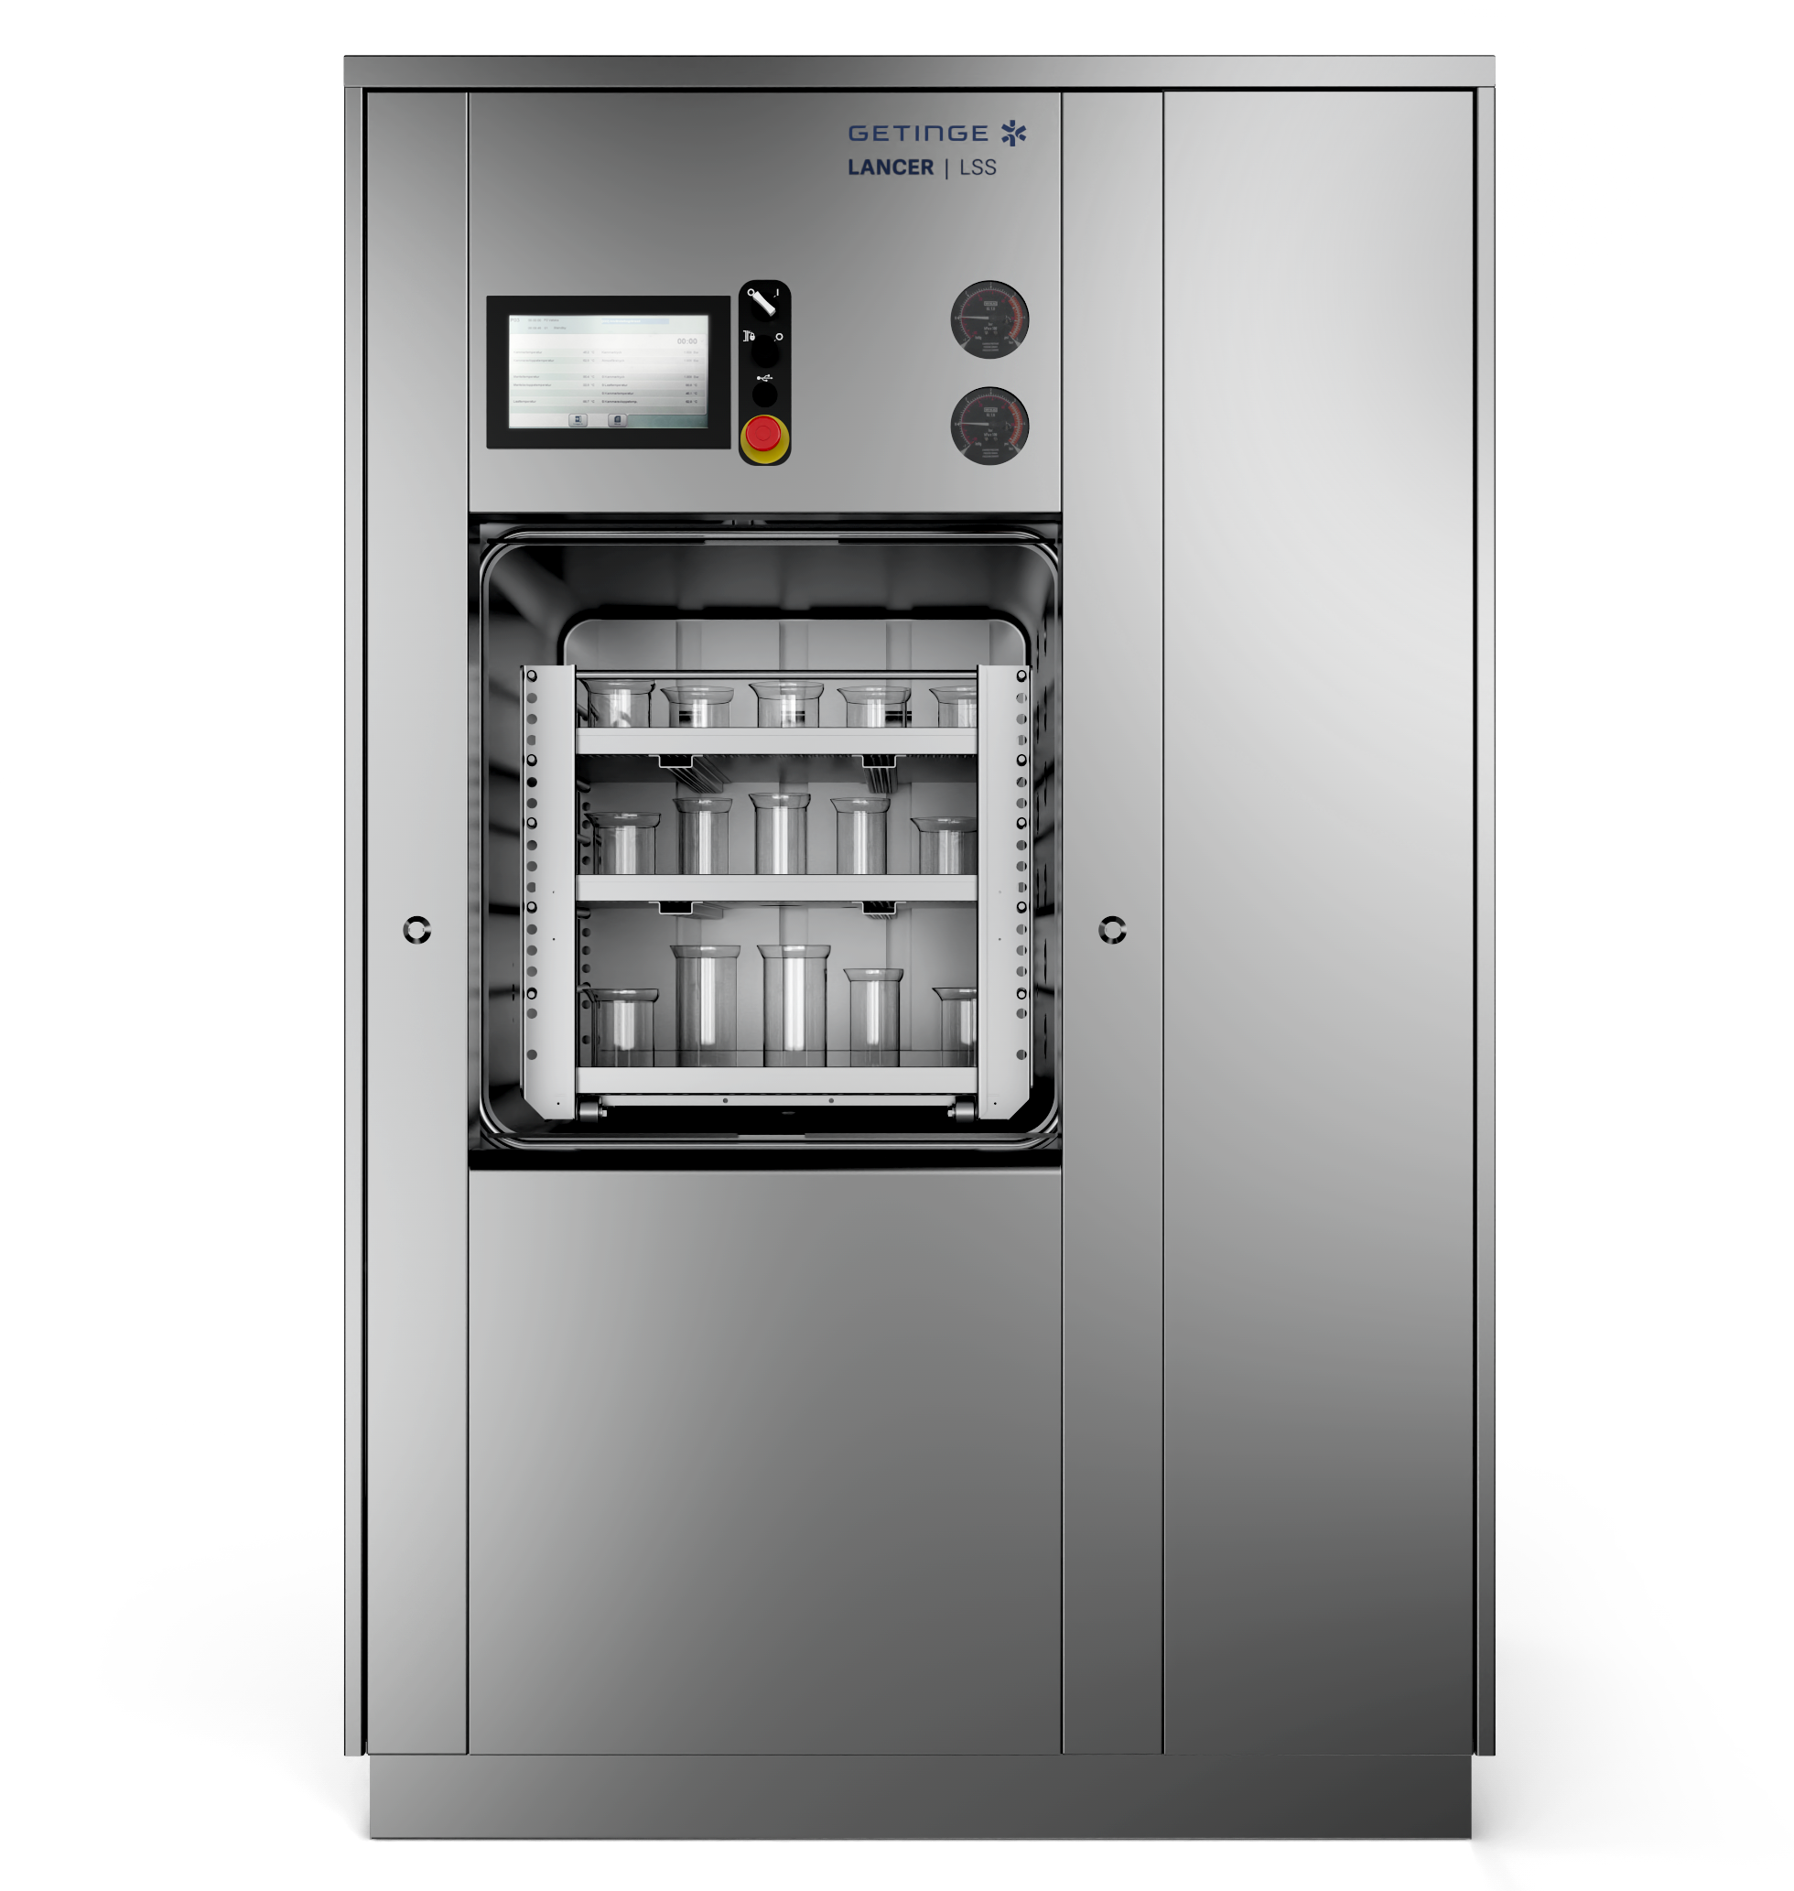
Cost-effective design
Designed for your lab environment
Intuitive HMI
Optional panel printer
Quality components help to support long usage and minimal downtime.
Large chamber
Vertical
door
Stainless steel construction
Optional
Integral steam generator

Slide 7
Choose your configuration
Lancer LSS comes in three different sizes
Model | Sterilizer Dimensions mm |  |  | Usable Chamber Dimensions mm |  |  | Chamber Volume (Nominal Internal)
 | Width | Height | Depth single / double door | Width | Height | Depth | Litres
340 | 1250 | 1980 | 1279 / N/A | 660 | 700 | 700 | 340
480 | 1250 | 1980 | 1330 / 1350 | 660 | 700 | 1000 | 480
620 | 1250 | 1980 | 1630 / 1650 | 660 | 700 | 1300 | 620

Slide 8
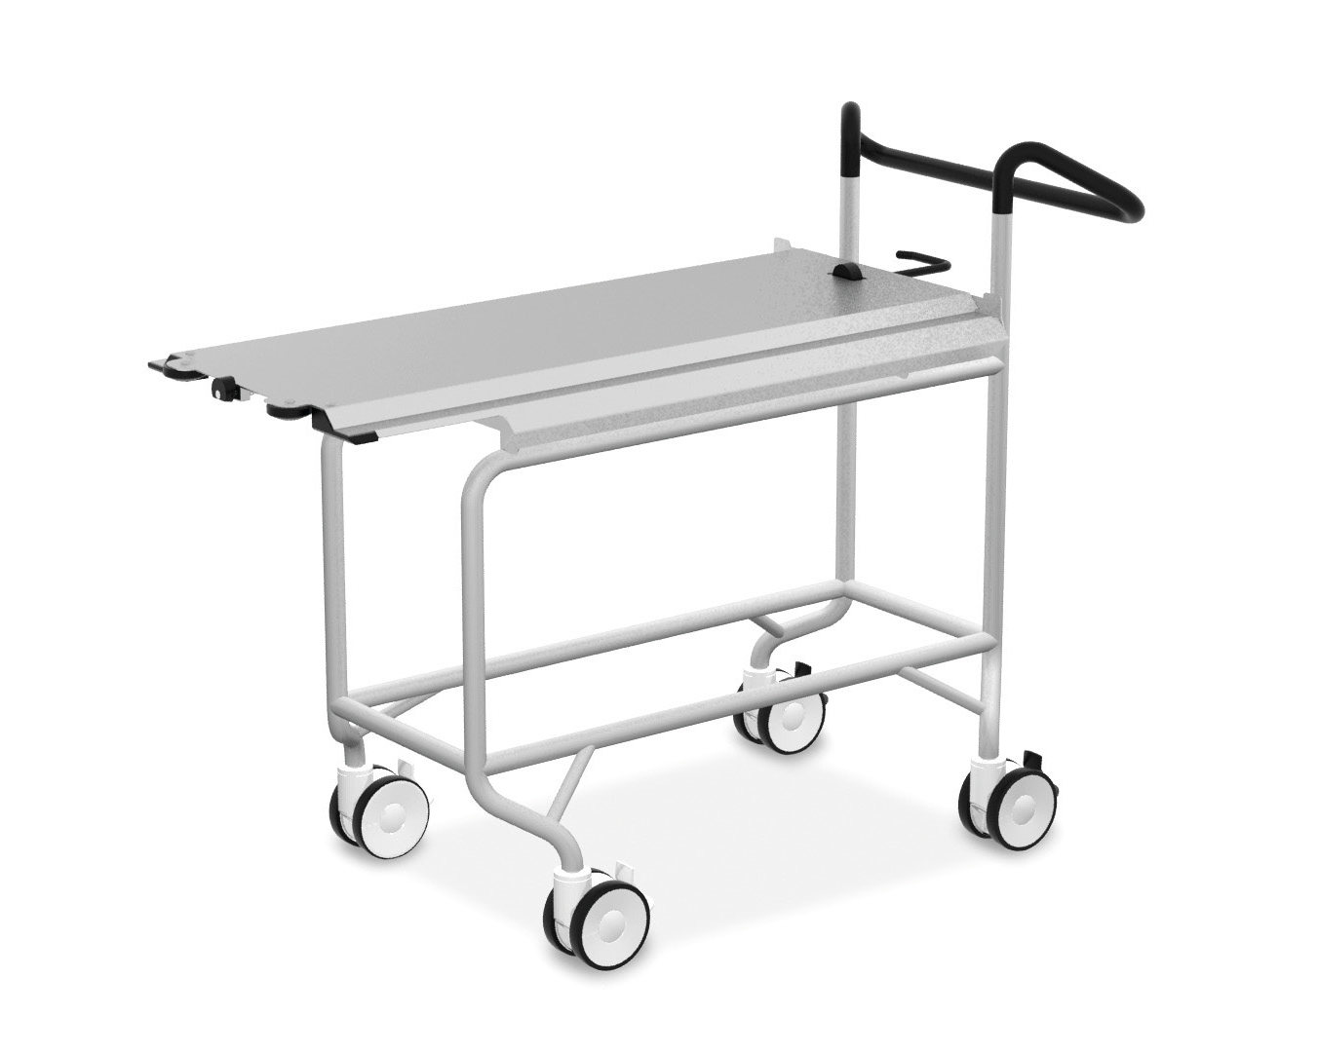




Customise your Lancer LSS
Accessories to help streamline workflows
Our range of open wire shelves, transfer carts and other accessories help you make the most efficient use of the interior chamber space. All racks and shelves are specific to the cabinet size.
Withdrawable shelf
Shelf
rack
Fixed height trolley
Height adjustable trolley

Slide 9


Service without borders
Predictive and reactive maintenance to maximise uptime
Our services include:
+ Spare parts packages
+ Calibration services
+ Upgrade packages
+ Operator and technician training
+ Process verification
+ Validation services
A service agreement with Getinge is designed to give you maximum uptime and allows you to focus on your research.
Lancer LSS can also connect with Getinge Online, enabling you to monitor your equipment from anywhere.

Slide 10
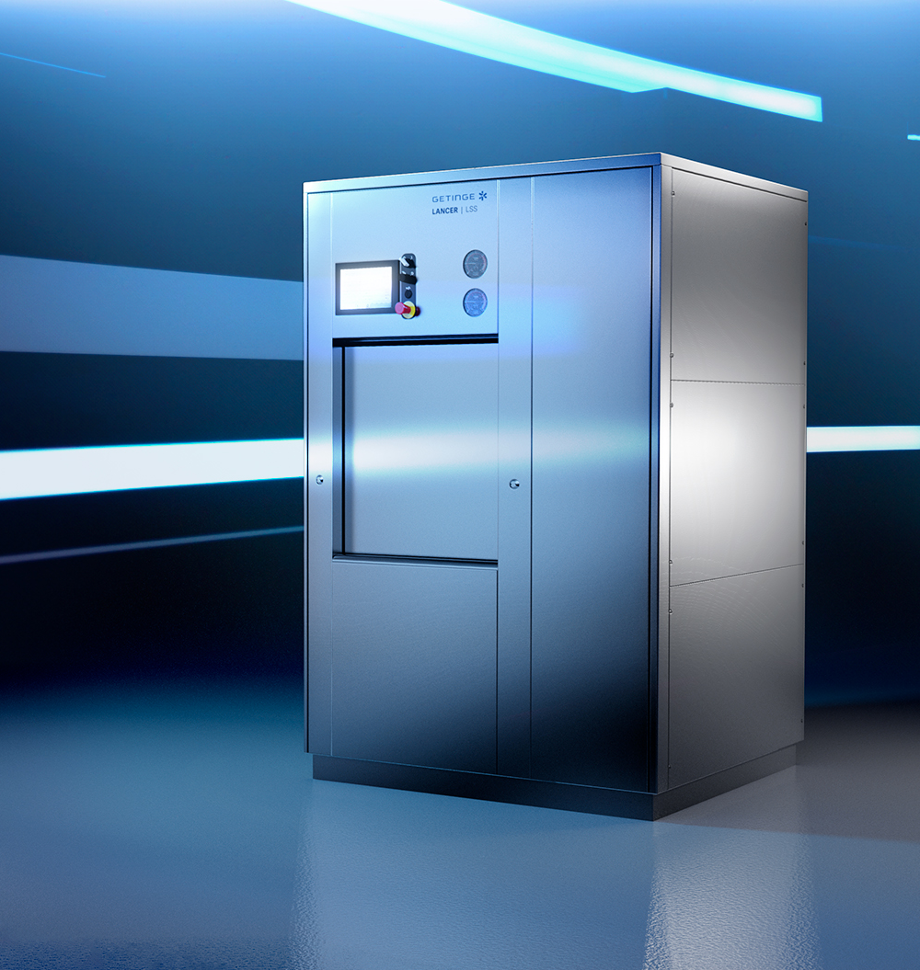
Upgrade your lab
Increase your efficiency
+ Robust construction to withstand your laboratory conditions
+ Pre-programmed and customisable sterilization cycles - gives process flexibility to meet most load types typical for lab applications.
+ Process monitoring and batch reports to document results
+ Intuitive HMI for easy operation and reduced human error
+ Connectivity to Getinge Online to monitor
your equipment remotely
+ Cost-effective solution – fulfill laboratory requirements within your budget

Slide 11
ANZ_LS_V1_011_0724 | EXP 08/24

